Slide 1
RPL Based Energy-Efficient Routing Protocol for IoT
Madhurjya Saha
(320519019)
Superviser:
Dr. Surajeet Ghosh

Slide 2
Contents
Low Power and Lossy networks (LLNs)
Introduction to RPL
Topology in RPL - DODAGs
Rank in DODAG
RPL control messages - DIS, DIO, DAO, DAO-ACK
DAG Metric Container option in DIO
Objective Functions
Problem with Standard RPL
Proposed solution
Overview of Simulator and Network Setup
Simulation Results
Conclusion

Slide 3
Low-Power and Lossy Networks
Low power and Lossy Networks (LLNs) are resource-constrained
Constrained nodes with limited power, memory and processing resources
Interconnected by variety of links such as
IEEE 802.15.4 or low-power WiFi

Slide 4
RPL
RPL is a distance-vector and source routing protocol
Network topology – Destination oriented Directed Acyclic Graph (DODAG)
RPL defines three types of nodes – Low-power and Lossy Border routers(LBR), Router and nodes

Slide 5
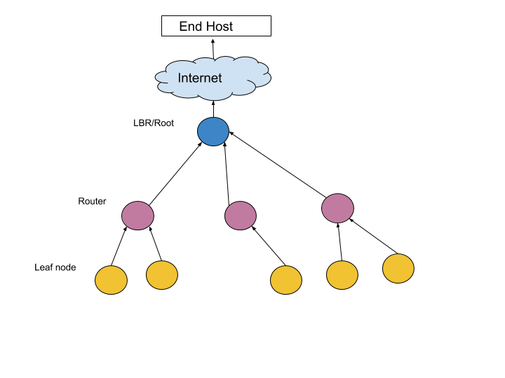
DODAG
Fig 1: DODAG Topology in RPL

Slide 6
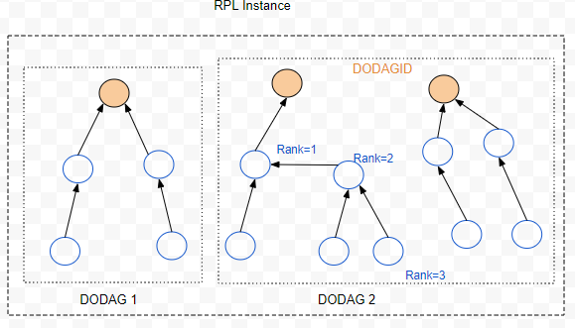
Rank defines the node’s individual position relative to other nodes with respect to the DODAG root
Fig 2: An RPL instance with two DODAGs

Slide 7
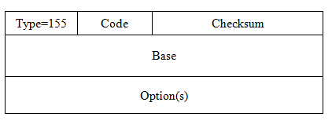
RPL control messages are ICMPv6 messages
Fig 3: RPL control message packet format
Code: Identify the type of control message
0x00: DODAG Information Solicitation (DIS)
0x01: DODAG Information Object
0x02: Destination Advertisement Object (DAO)
0x03: DAO-ACK

Slide 8
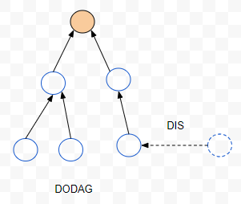
DODAG Information Solicitation (DIS)
Solicit a DODAG Information Object (DIO) from an RPL node
Fig 4: A neighboring node sending DIS message

Slide 9
DODAG Information Object (DIO)
Carries information that allows a node to-
Discover an RPL instance
Learn its configuration parameters
Select a DODAG parent set root
Maintain the DODAG
DIO
Fig 5: Root node sending DIO message

Slide 10
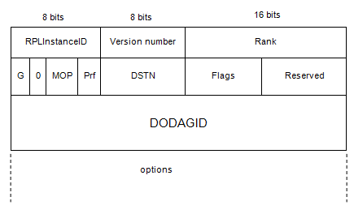
DODAG Information Object (DIO)
Fig 6: DIO message format

Slide 11
DODAG Information Object (DIO)
DIO transmission is based on trickle timer algorithm
Whenever some inconsistent network management is received, frequency of DIO transmission is increased
Configuration parameters of trickle timer – I_{min}: minimum DIO interval
I_{max}: maximum DIO interval
k: redundancy constant

Slide 12
Destination Advertisement Object (DAO)
Used to propagate destination information upward along the DODAG
In storing mode, the DAO message is unicast by the child to the select parent
In non-storing mode, the DAO message is unicast to the DODAG root
Root
DAO
Fig 7: DAO message from child to parent node

Slide 13

DAG metric container
The DAG Metric Container option MAY be present in DIO or DAO messages
The DAG Metric Container is used to report metrics along the DODAG
Fig 8: DAG metric container format

Slide 14
Node metric/constraint objects:
Node state and attribute object
Node energy object
Hop count object
Link metric/constraint objects:
Throughput object
Link reliability
Latency

Slide 15
Objective Function(OF)
Defines how RPL nodes select and optimize routes within an RPL instance
How nodes translate one or more metrics into a rank
How nodes select parents (next hop)

Slide 16
Objective Function(OF)
Objective Function 0 (OF0) uses hop count
Chooses minimum possible hops from source to root
Minimum Rank with Hysteresis objective function (MRHOF) uses ETX as primary metric
Designed to find the path with minimum path cost

Slide 17
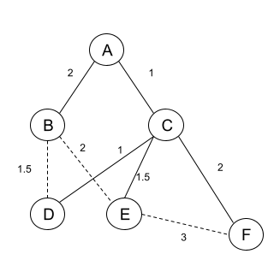
Problem description
Fig 9: An Example of DODAG construction and parent node selection. The numbers beside the edges denote ETX values of the links.

Slide 18
Proposed solution
To improve the network performance by considering link quality (ETX) as well as residual energy (BDI) of the nodes.
To design an OF: which takes the residual energy of the nodes and cumulative ETX of the link for parent selection

Slide 19
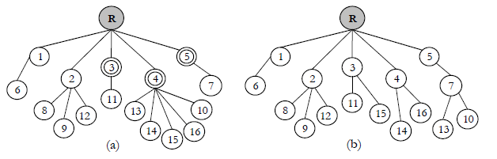
Proposed solution
Fig 10: Avoiding bottleneck nodes using proposed OF

Slide 20
Proposed solution
Routing metrics:
1) Expected Transmission Count (ETX)
ETX =
2) Battery Depletion Index (BDI) =
Energy_consumed =

Slide 21
OF design using composite metric ETX and BDI
Input: DIO from neighbors
Output: Preferred parent selection
The node calculates the rank based on ETX and BDI
minOF(ETX, BDI) = w1* ETX + w2* BDI
If the rank of any node becomes less than rank of the existing parent node, the new node becomes the preferred parent

Slide 22
Overview of Simulator
The proposed scheme is evaluated using Cooja simulator of the Contiki 3.0 OS
It is an open source OS for wireless sensor networks – can emulate different hardware motes
Contiki has a reliable implementation of RPL- ContikiRPL

Slide 23
Simulation Network Setup
Parameter | Value
Operating System | Contiki 3.0
Simulator | Cooja
Number of nodes | 25-50 nodes
Routing protocol | RPL protocol
Transmission Range | 50 m
Area | 300m × 300m
Simulation Time | 300 sec
Objective Function | MRHOF, Composite RPL
Radio medium model | UDGM – Distance loss
Mote type | Tmote sky
Topology | Random topology
Full Battery | 1000 mJ
RPL parameter | MinHopRankIncrease = 256

Slide 24
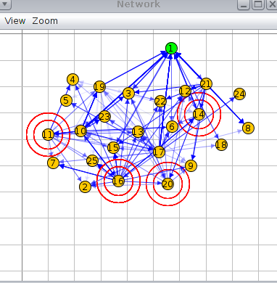
Simulation with 25 nodes
Fig 11: RPL random topology with 25 nodes

Slide 25
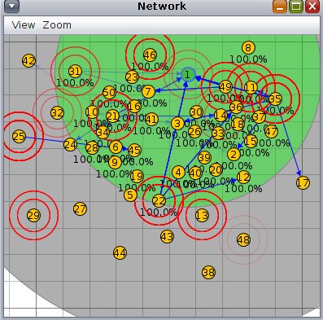
Simulation with 50 nodes
Fig 12: RPL random topology with 50 nodes

Slide 26
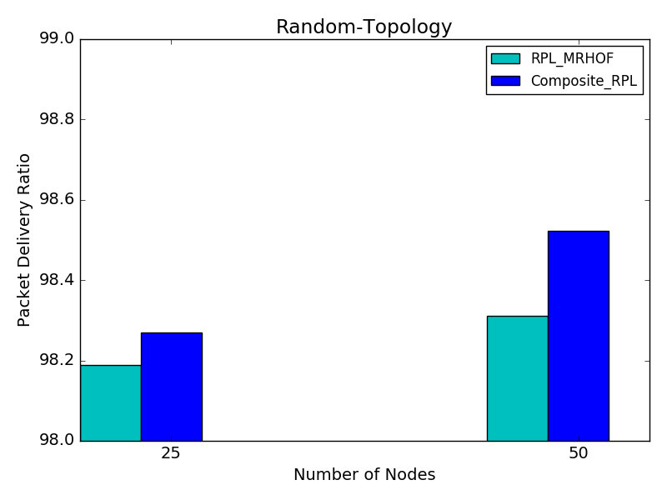
Simulation Results
Fig 13: PDR as a function of varying number of nodes

Slide 27
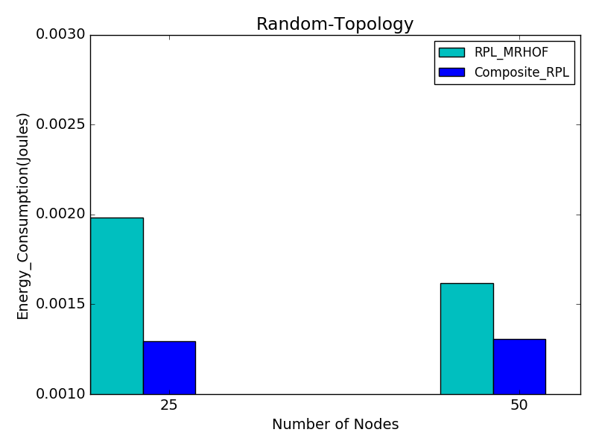
Simulation Results
Fig 14: Average energy consumption of the nodes vs number of nodes

Slide 28
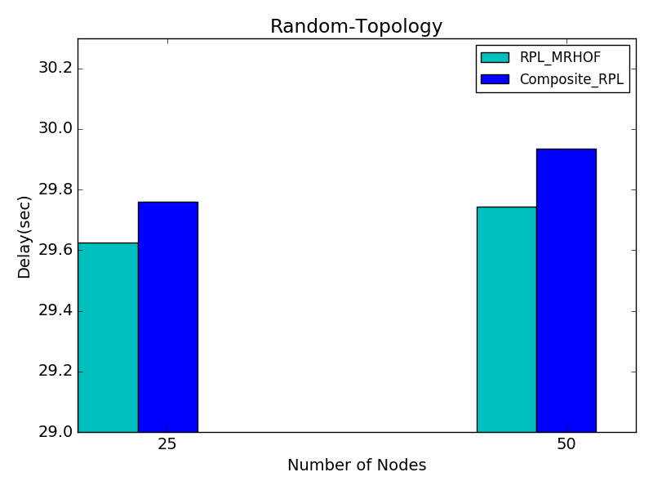
Simulation Results
Fig 15: End-to-end delay as a function of varying number of nodes

Slide 29
Conclusion
Different application scenarios demand different networking requirements.
This work proposes an improvement to the existing RPL by considering factors like node's battery level and link quality into consideration in the next hop selection.
Simulation of the proposed approach evaluated node’s battery consumption, packet delivery ratio and latency.

Slide 30
Future Scope
Other matrices for traffic congestion can be included, like number of child nodes or Buffer occupancy
Weights assigned to each metric can made adaptive, depending on link quality, battery level and congestion around nodes at run-time

Slide 31


